Slide 1
Swiss Smart Factory powered by Microsoft Cloud
Urs Rüegg, Solution Architect

Slide 2
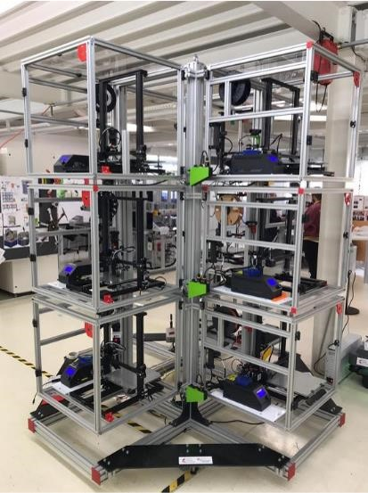
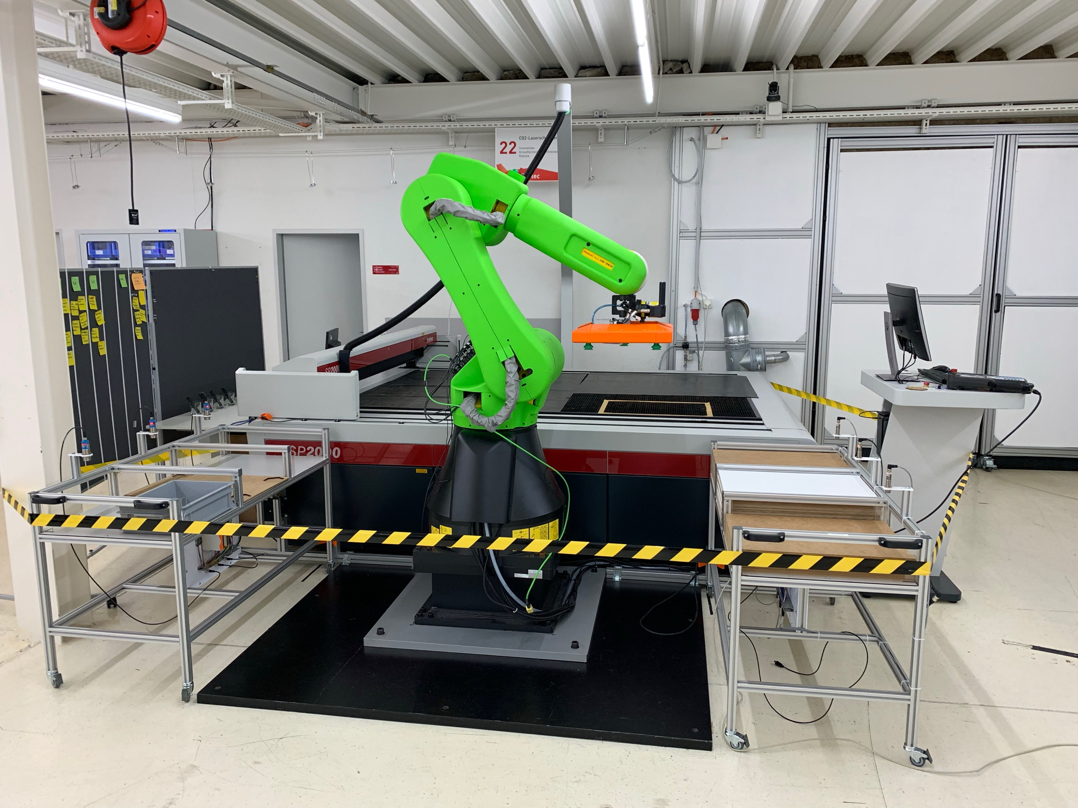











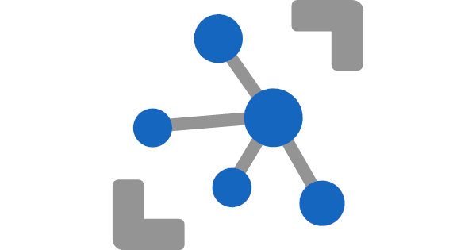






Swiss Smart Factory powered by Microsoft Cloud
Devices
Applications
Microsoft
Teams
Collaboration
Remote
Assist
Guide
Daily Check
Inspection
Power Apps
Daily Check
Tour Guide
Welcome Desk
Connected
Field Service
Monitoring
Inspection
Power BI
Connected
Factory
3D Printer
Farm
Laser as a Service
Azure
Dynamics 365
Registration
and Commands
Logic App
Dynamics
to Azure
Azure
Service Bus
Fault
Alert
Azure
IoT Edge
Azure
IoT Hub
Azure
Stream Analytics
Azure
Service Bus
Logic App
Azure
to Dynamics
Connected
Field Service
Microsoft Dataverse
Functional Location
Customer Assets
Device. Alerts
Case, Work Orders
Inspection
Azure Time
Series Insights
Azure SQL
Reporting

Slide 3


Swiss Smart Factory powered by Azure Digital Twins
Devices
Applications
Power Apps
Tour Guide
Power BI
Connected
Factory
3D Printer
Farm
Laser as a Service
Azure Digital Twins
Azure
Building
SSF
Azure
Functions
Sets data on model
ProcessDTRoutedData
Lifecycle events
Telemetry messages
Level Factory
Temparature
Humidity
Azure
IoT Edge
Azure
IoT Hub
Azure
Functions
Process telemetry
ProcessHubToDTEvents
3D Printer Farm
Laser as a Service
Event Grid
ProcessDTRoutedData
hasCapability
hasCapability
Temparature
Temparature
…
…

Slide 4
Swiss Smart Factory Azure Digital Twins modeled as a topology graph
Using RealEstateCore ontology to Swiss Smart Factory graph
isPartOf
serves, feeds
isPartOf
serves, feeds
Space
Asset
Building
SSF
locatedIn
serves
extends
extends
Level Factory
Temparature
Building
Room
hosts
Equipment
Humidity
serves
3D Printer Farm
Laser as a Service
serves
Capability
LogicalDevice
hasCapability
hasCapability
hasCapability
extends
isPartOf
Temparature
Temparature
Sensor
Actuator
Parameter
Space Interface
…
…
Asset Interface
Capability Interface
RealEstateCore ontology
LogicalDevice Interface

